Slide 1
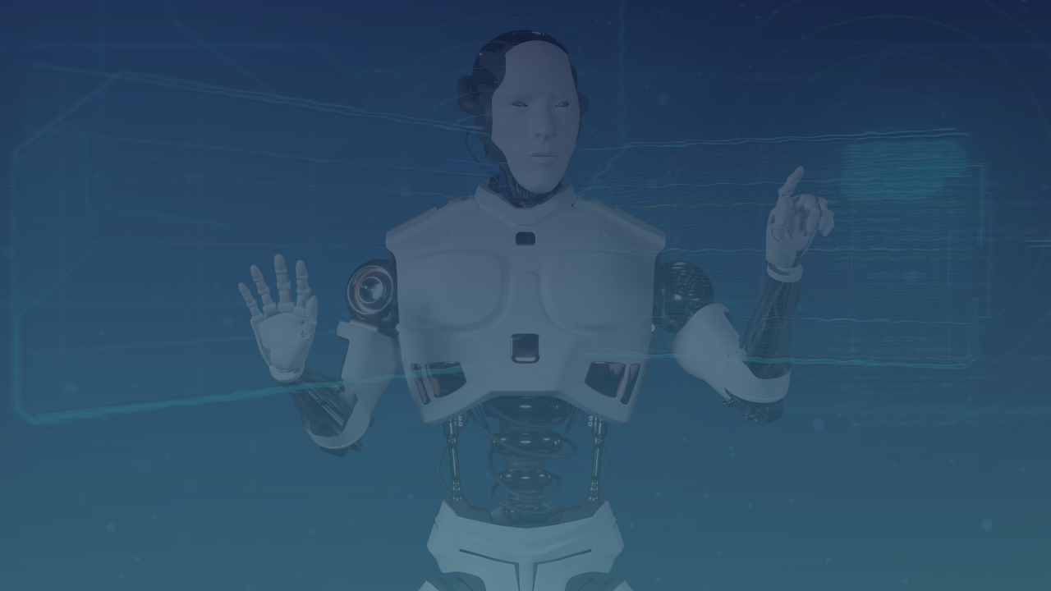



ML TASK 2
SOCIAL
NETWORK ADS
A Machine Learning Project with Flask Web Deployment
👩‍💻 Project by: Ritika Jaiswal
💡 Task Assigned by: Kamal Sir

Slide 2


PROBLEM
STATEMENT
The task is to build a machine learning model to predict whether a user is likely to buy a product based on:
Age (years) and
estimated Salary (Rs).

Slide 3

COMPANIES AND ADS PLATFORMS USE SUCH MODELS TO:
1.
🎯 TARGETED ADVERTISING
Show ads to users most likely to purchase
USE
2.
💰 OPTIMIZED AD SPEND
Avoid wasting money on uninterested users
CASE
3.
👥 AUDIENCE SEGMENTATION
Group users by predicted buying behavior
4.
✨ PERSONALIZED CAMPAIGNS
Deliver customized ads for better ROI

Slide 4
DATASET
SUMMARY
🔹 INPUT FEATURES
User ID | Gender | Age | EstimatedSalary
15624510 | Male | 19 | 19000
15810944 | Male | 35 | 20000
15668575 | Female | 26 | 43000
15603246 | Female | 27 | 57000
🔹 TARGET VARIABLE
Purchased | 0/1 (Binary Output)

Slide 5
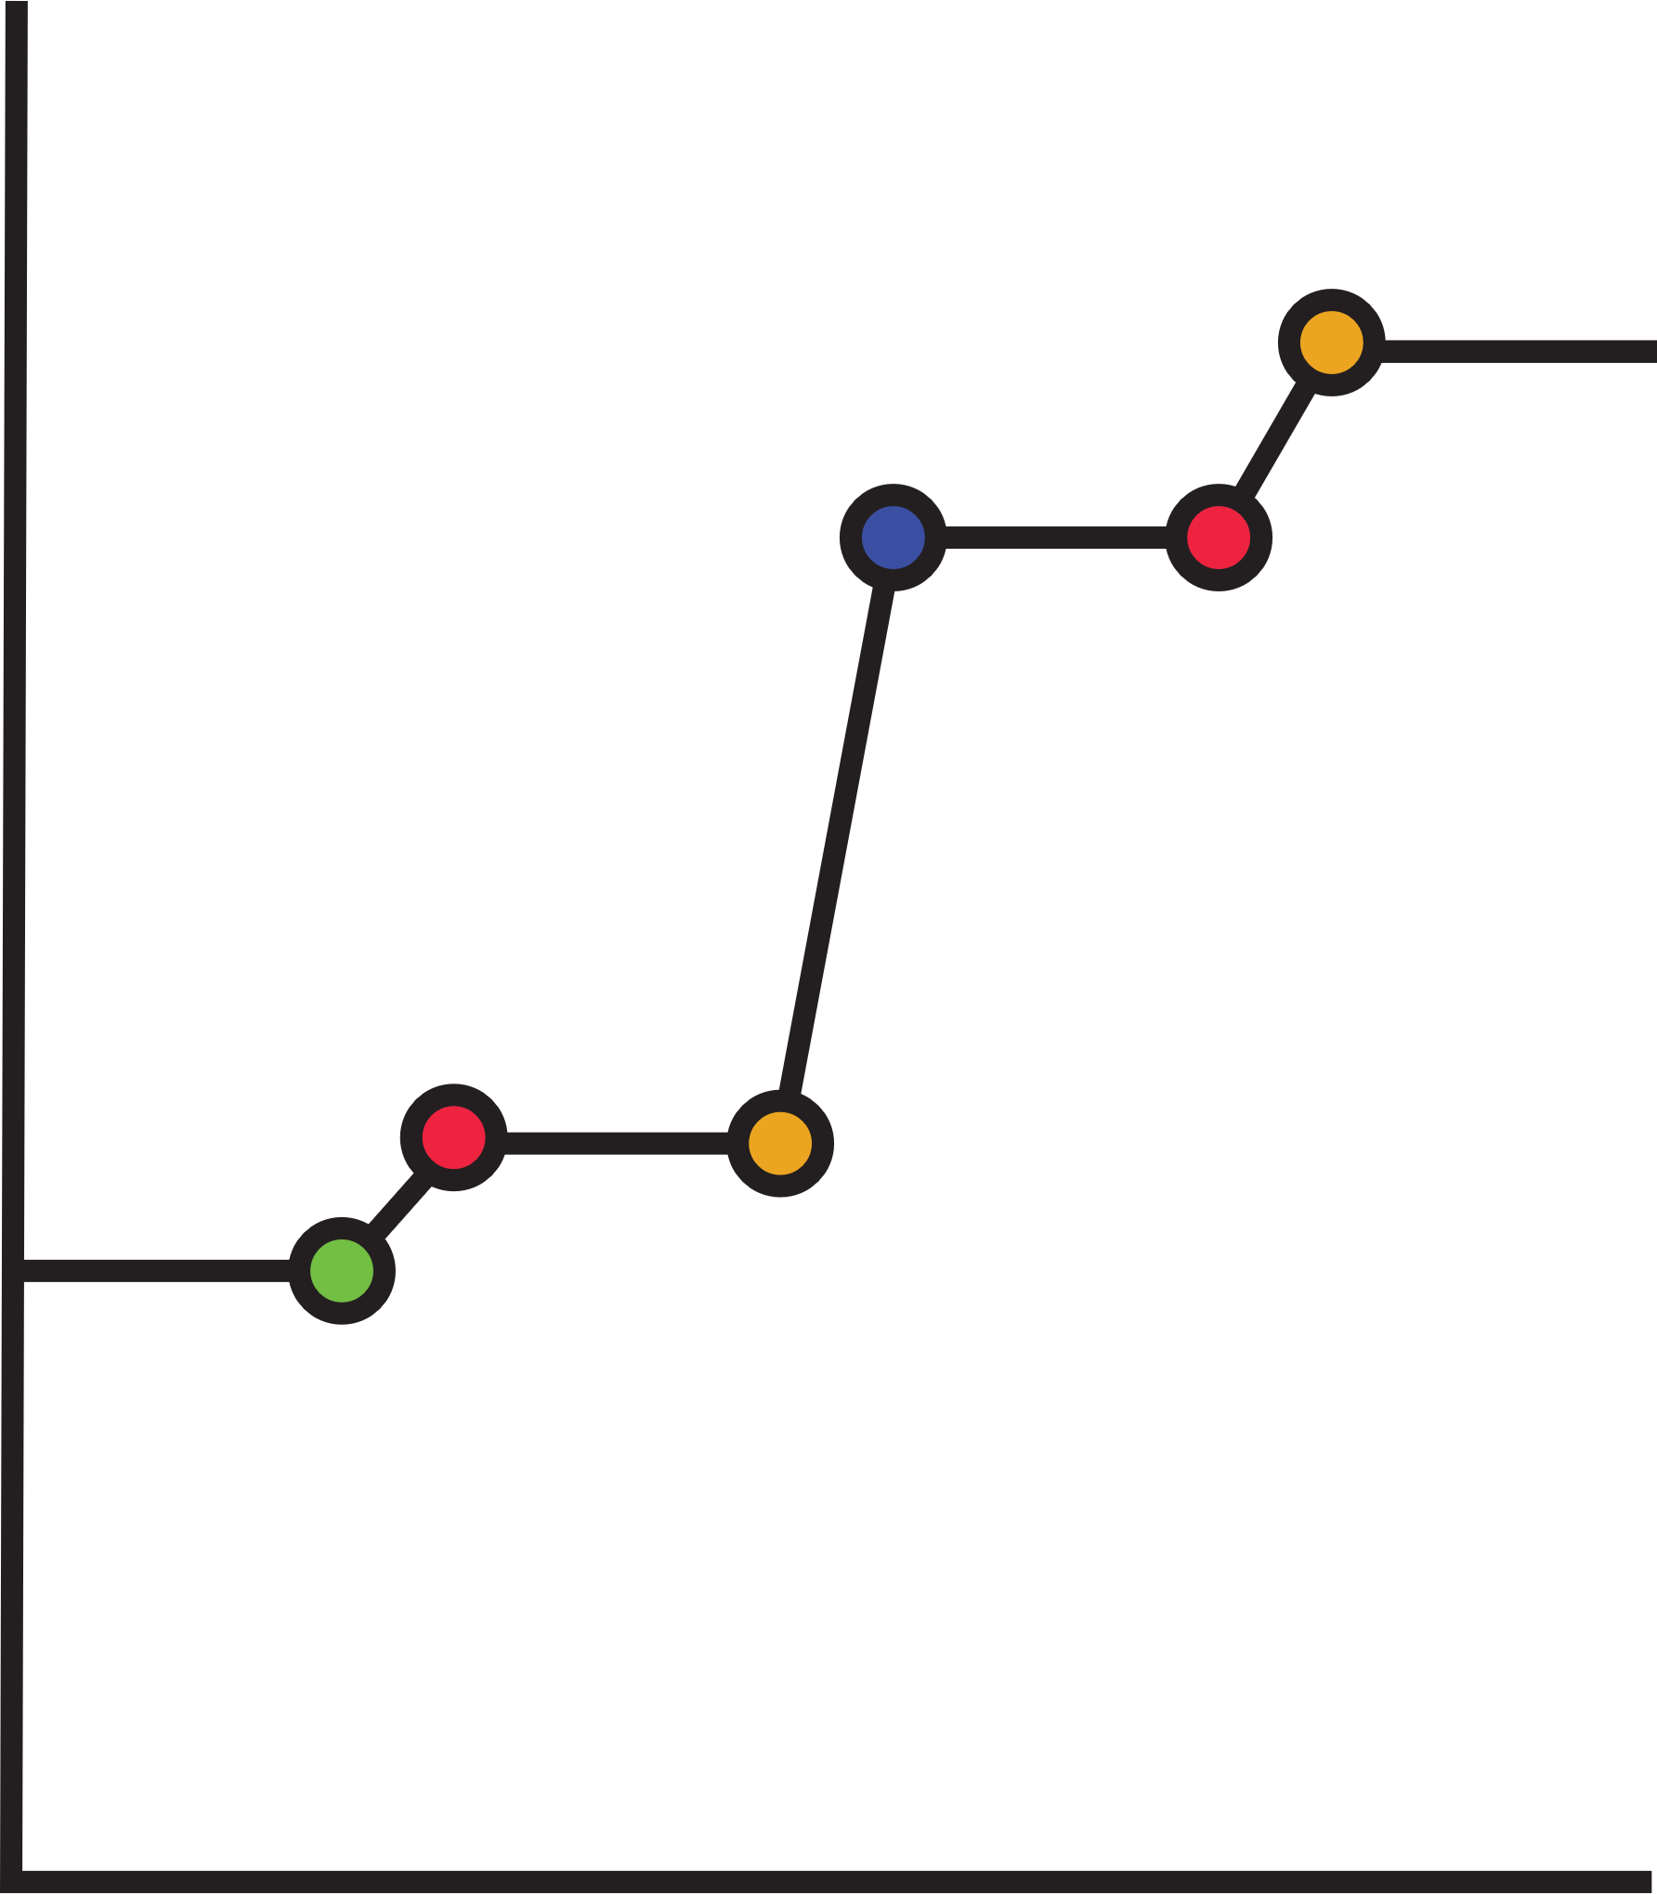
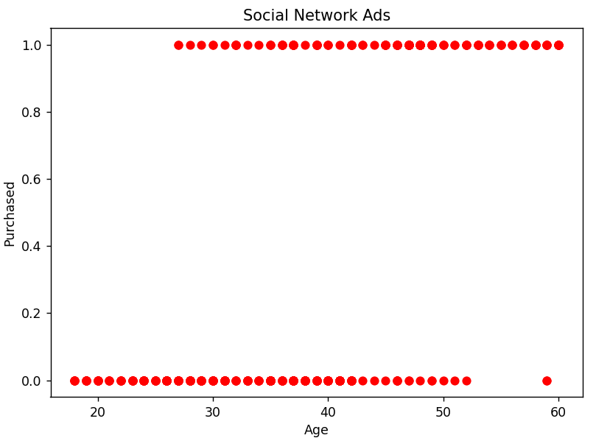
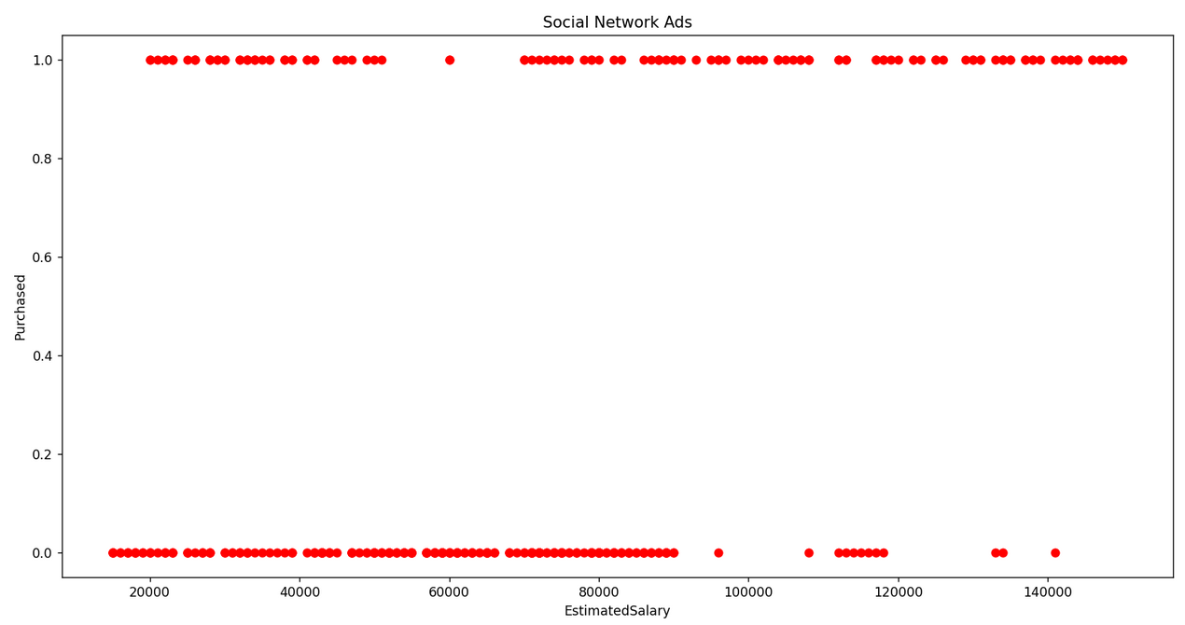
DATASET
VISUALIZATION
🛒 PURCHASE DECISION BY SALARY
🧑‍🤝‍🧑 CUSTOMER AGE & BUYING BEHAVIOR

Slide 6
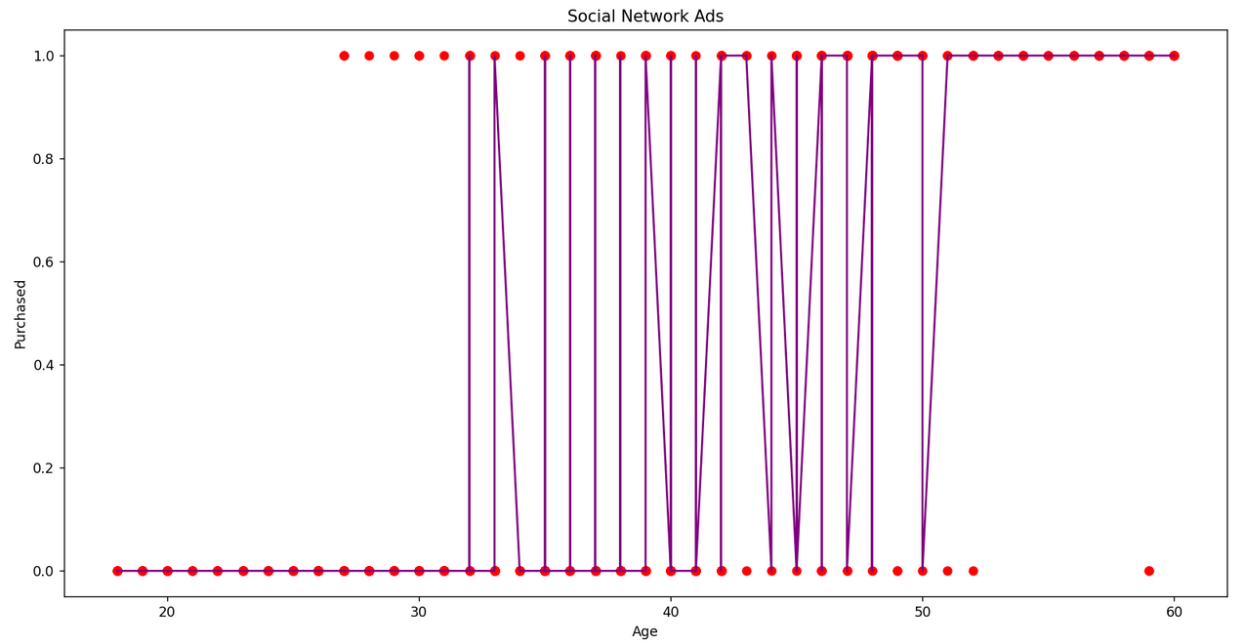
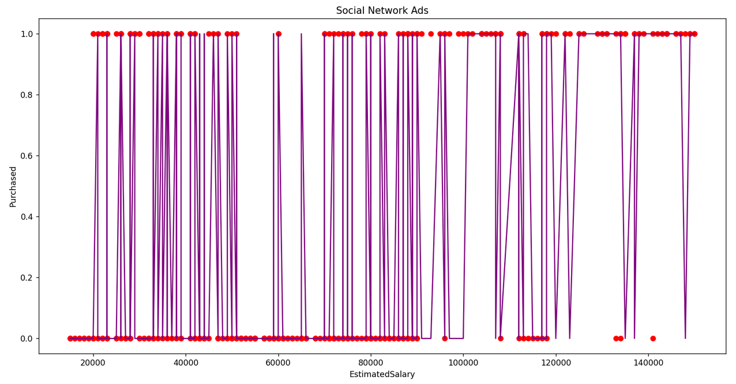
🎯 CLASSIFICATION BOUNDARY PLOT
📊 DECISION BOUNDARY SEPARATING PURCHASED VS NOT PURCHASED BASED ON ESTIMATED SALARY
📊 DECISION BOUNDARY SEPARATING PURCHASED VS NOT PURCHASED BASED ON AGE

Slide 7
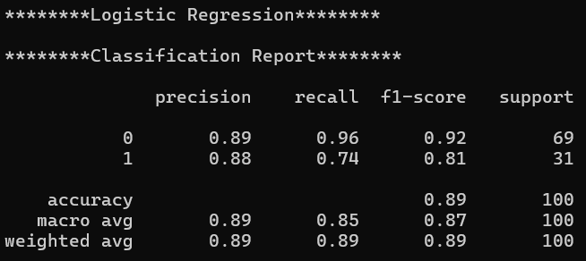
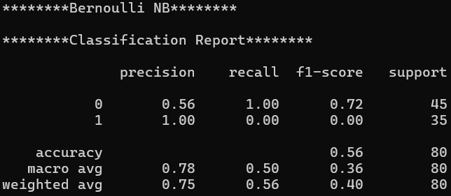
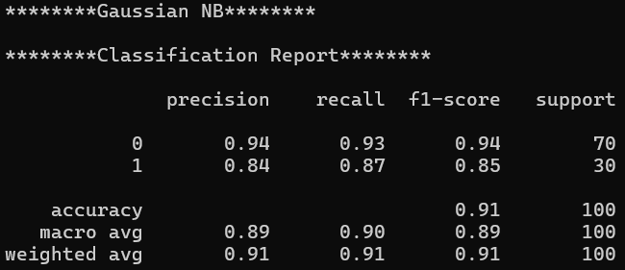
COMPARING VARIOUS CLASSIFICATION ALGORITHM
1.
LOGISTIC REGRESSION
Logistic Regression achieved 89% accuracy, performing strongly on class O but with lower recall for class 1.
2.
BERNOULLI NB
Bernoulli NB achieved 56% accuracy, predicting all class 0 correctly but completely failing to recall class 1.
3.
GUASSIAN NB
Gaussian NB achieved 91% accuracy, performing well on both classes with slightly lower precision and recall for class 1.

Slide 8
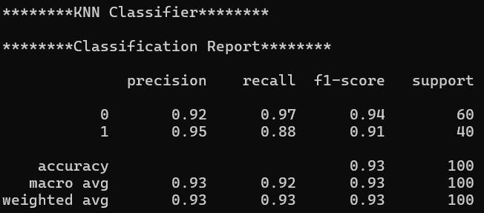
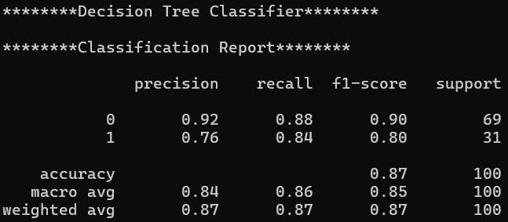
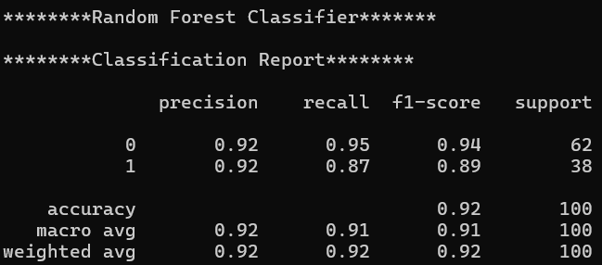
COMPARING VARIOUS CLASSIFICATION ALGORITHM
4.
KNN CLASSIFIER
This classification report shows that the KNN classifier achieved high overall accuracy (93%) with strong precision and recall for both classes.
5.
DECISION TREE CLASSIFIER
This classification report shows that the Decision Tree classifier achieved an overall accuracy of 87%, with better performance on class O than class 1.
6.
RANDOM FOREST CLASSIFIER
This classification report shows that the Random Forest classifier achieved a high accuracy of 92%, with balanced and strong performance across both classes.

Slide 9





MODEL SELECTION AND PREPROCESSING
04 Model Initialization
Created Random Forest with n_estimators=10 and fixed random_state=6 for
reproducibility.
01 Data Cleaning
Checked for missing values using .isnull().sum() to ensure data quality.
03 Train-Test Split
Divided data into training and testing sets using
train_test_split() for unbiased evaluation.
02 Feature Selection
Selected Age and EstimatedSalary as features, and Purchased as the target variable.
05 Model Training
Trained the Random Forest model on training data (x_train, y_train)
07 Model Serialization
Saved the trained model into model.pkl using pickle, enabling reuse without retraining.

Slide 10
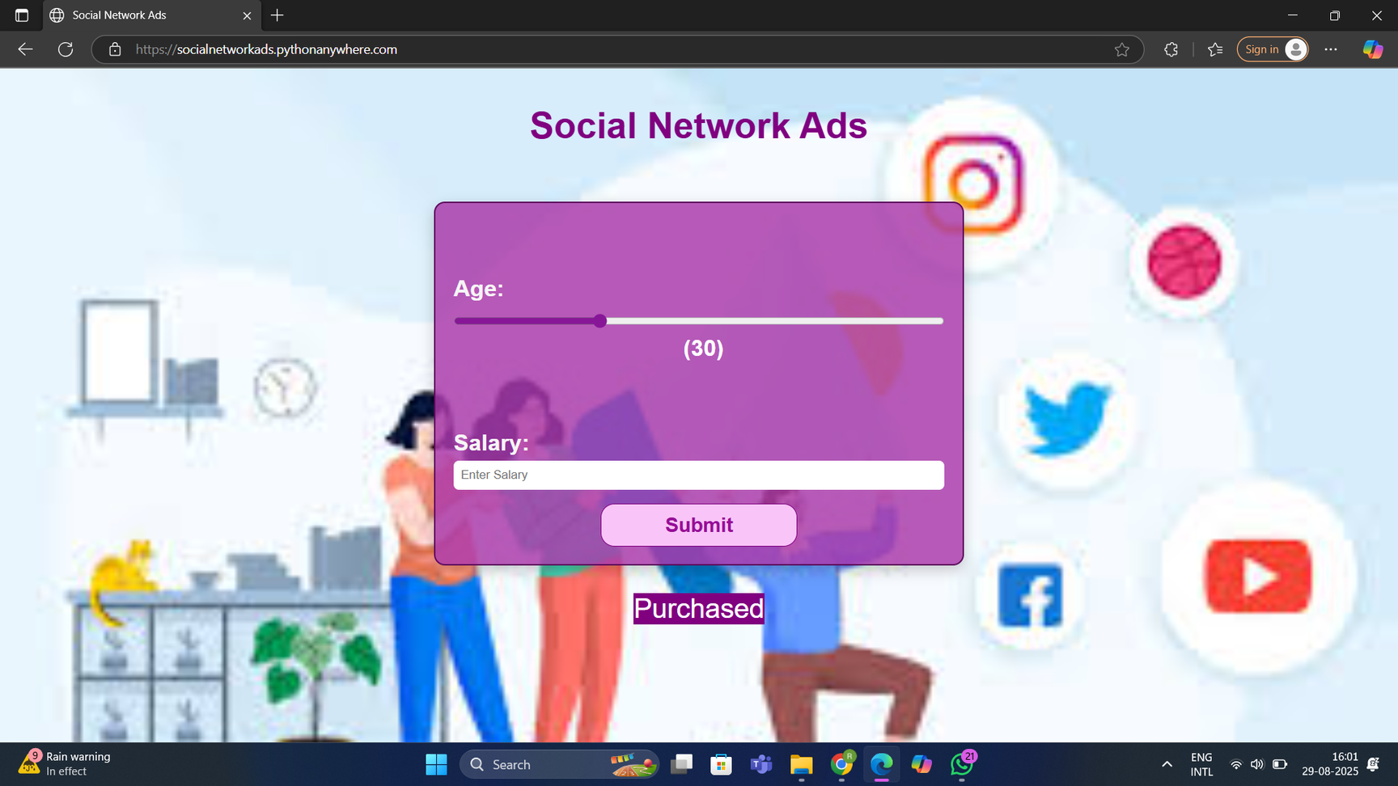
SOCIAL NETWORK ADS -
PROJECT INTERFACE
https://socialnetworkads.pythonanywhere.com/
VIEW PROJECT ONLINE:

Slide 11

TOOLS AND
TECHNOLOGIES USED
✅ 1. Python (v3.10 or v3.11)
Core programming language used for data processing, model building, and backend scripting.
✅ 2. Notepad
Used for writing and testing machine learning code interactively.
✅ 3. Flask (v2.x)
Python web framework used to build the web application.
Helps serve the ML model and take user input through a web interface.
✅ 4. HTML, CSS & JavaScript
For creating the frontend user interface (car image buttons, input sliders, and styled output).
📚 Libraries Used
✅pandas (v1.5+) - For data loading, exploration, and preprocessing.
✅matplotlib (v3.6+) - For data visualization like scatter plots and trend lines.
✅sklearn (v1.2+) - To build machine learning models (KNN, Decision Tree, Random Forest).
✅pickle - To save and load the trained ML model.
🌐 Hosting Platform
PythonAnywhere

Slide 12
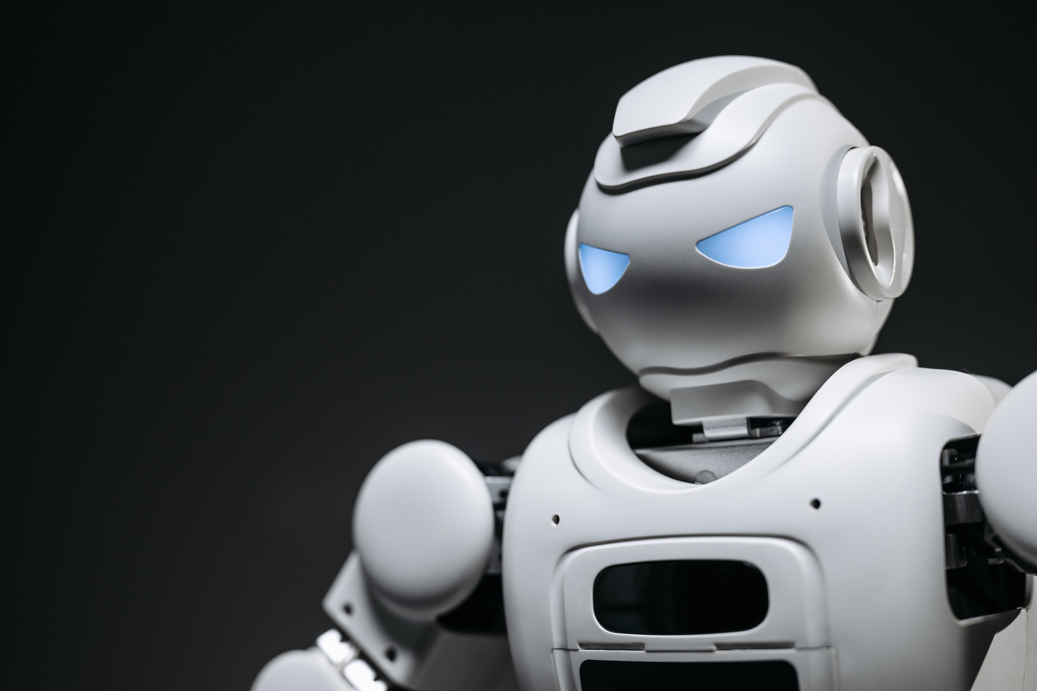
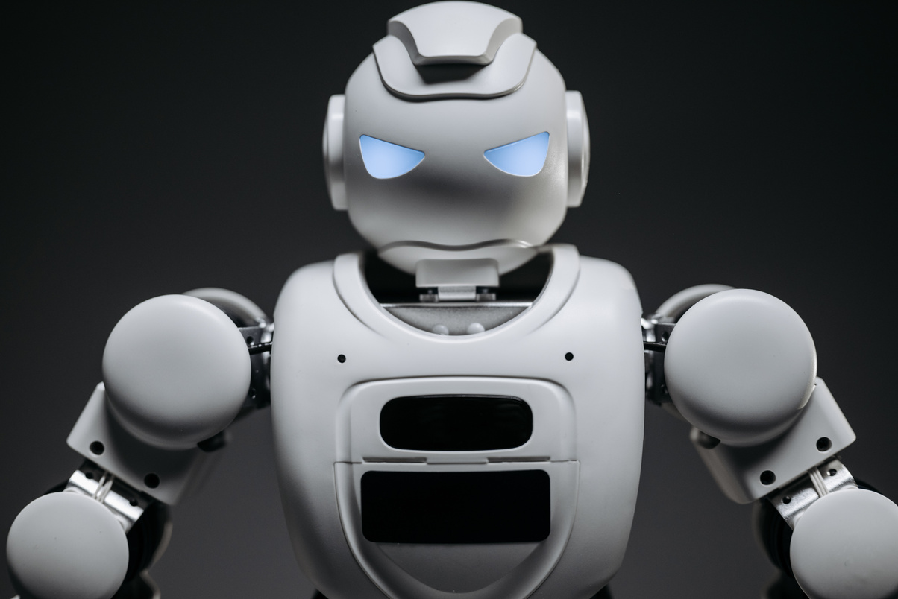
LEARNING
Gained hands-on experience with various classification models (Logistic Regression, Random Forest, Naïve Bayes, etc.)
1.
Understood and applied evaluation metrics like confusion matrix, precision, recall, F1-score, and classification report.
2.
3.
Explored train-test splitting to evaluate model performance and avoid overfitting.
4.
Practiced model saving & reusability using pickle for deployment-ready ML solutions.
5.
Understood which model to choose by comparing their accuracy scores.

Slide 13
THANK
YOU!
I would like to sincerely thank Mr. Kamal Sir for assigning me this project.
Working on this task gave me the opportunity to apply the Machine Learning concepts I learned in class.
It helped me strengthen my understanding and improve my practical skills.
This project was a great learning experience that boosted my confidence in applying ML techniques.

